Slide 1

2
Project
Sprint

Slide 2
Index
1
4
Teamwork methology and conflict resolution strategy
Main Objectives
2
Adopted development process and planning
5
Expected results
3
6
Product quality
Software delivery/sale

Slide 3



Main Objectives
Our software product aims to provide an efficient solution to our customer's specific needs. Thus, we created a new distance learning platform, eCourse, with the following main objectives:
ShareBoard/Meetings (collaboration tools) -> facilitates communication and collaboration between users.
Enrollment requests* Preview of future events (exams, classes...)
User Creation
Exam Creation/Validation
Creation of courses

Slide 4

Adopted
development
process
and planning
Our team takes a systematic and well-organized approach to the development process. We start by understanding your specific requirements and conducting thorough research. Then we use Agile methodology, in this case SCRUM, to ensure that the development process is iterative and collaborative.

Slide 5









Product quality
We use industry standard tools and technologies (JPA, ANTLR, Java, H2) to ensure that our software is stable, reliable and scalable. Our team has also performed rigorous testing to ensure that the software is error-free.
P.S.:Only the exam creation process including formative questions and exams needs to be improved.

Slide 6

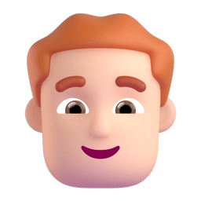





Teamwork methology and conflict resolution strategy
We also have a well-defined conflict resolution strategy that ensures that any issues are resolved in a timely and respectful manner.
We follow a teamwork methodology that encourages communication, collaboration, and mutual respect.

Slide 7

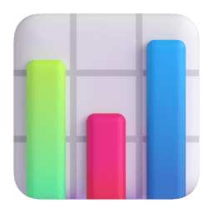
EXPECTED RESULTS
The application will provide an efficient and seamless experience for teachers, students and managers. For example, it will allow teachers to easily create formative exams and quizzes and share them with their students, students to enroll in courses, use a shared board with other users or participate in meetings and managers to create users, courses, accept enrollments, create a board and more.
The application will help improve the quality of teaching by providing teachers with tools to create interesting content and assessments tailored to students' needs.

Slide 8
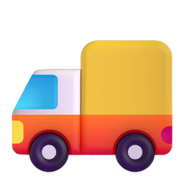






Software delivery/
sale
The software is delivered as a zip file that can be obtained from a member of the team.
The software is available for Windows, macOS and Linux platforms.
The software is not for sale and is intended for academic purposes only.

Slide 9
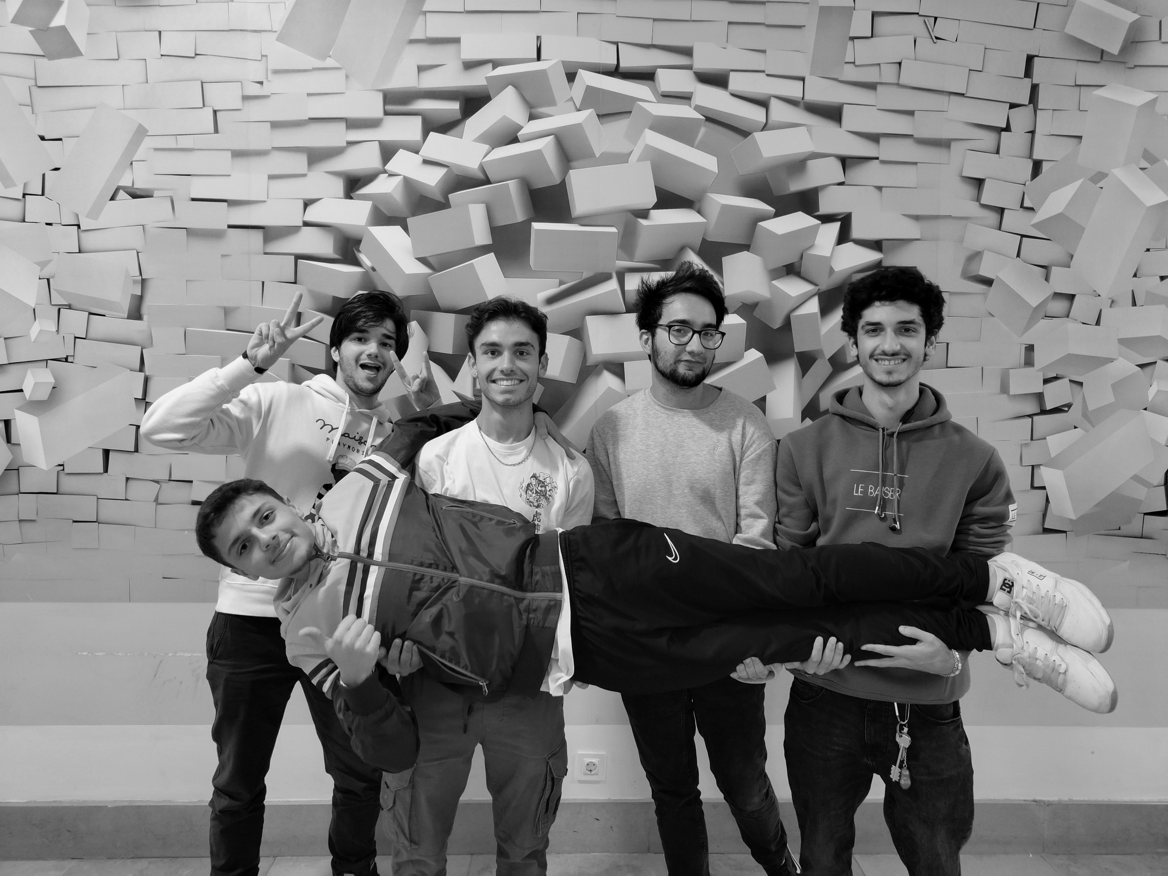
Team:
Sérgio Marques ( 1211705 )
Pedro Alves ( 1211702 )
Francisco Gouveia ( 1201264 )
Leonardo Miranda ( 1200824 )
Francisco Marques ( 1201850 )

